Slide 1

ANALYSIS ON IMDB MOVIES

Slide 2

PROBLEM STATEMENT:
What factors influence the success of a movie on IMDB?
OBJECTIVE:
Here , success can be defined by high IMDB ratings.The impact of
this problem is significant for movie producers,directors,and
Investors who want to understand what makes a movie success
to make informed decision in their future projects.

Slide 3

R.Kavya Sri
(MBA)
S.Uday
(BSc)

Slide 4

FLOW OF EDA:
Problem statement
Webscraping – Details (Websites, Process followed)
Summary of the Data
Exploratory Data Analysis:
Data Cleaning Steps
Data Manipulation Steps
Univariate Analysis Steps
Bivariate Analysis Steps

Slide 5
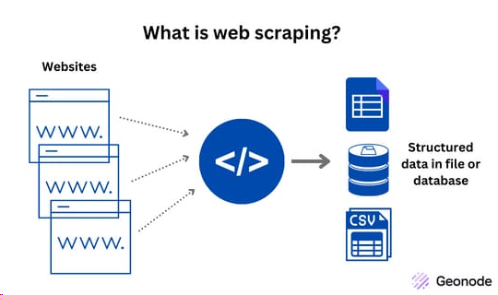
WEB SCRAPING:
Webscraping is a software technique of extracting information from the website it takes the unstructured data into structured data that can be stored and analyzed.
We have to send request to the URL of the webpage we want to access. The server responds to the request by returning the html content of the webpage . If we get the status code as 200 we can scrap the HTML context from webpage.
Beautiful soup is a python library that makes easy to scrape information and exacting the data from HTML files.

Slide 6

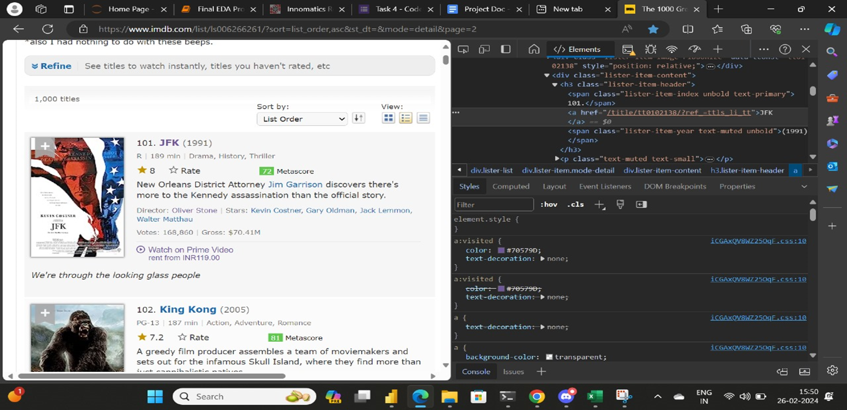
DATA COLLECTION:
Website :
UrlLink:https://www.imdb.com/list/ls006266261/?sort=list_order,asc&st_dt=&mode=detail&page=1

Slide 7








LIBRARIES
Request
BeautifulSoup
Regex(re)
Pandas
Numpy
Matplotlib
Seaborn

Slide 8

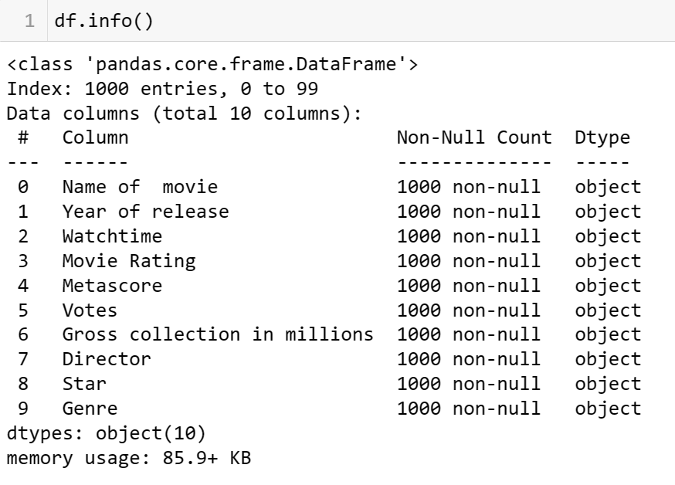
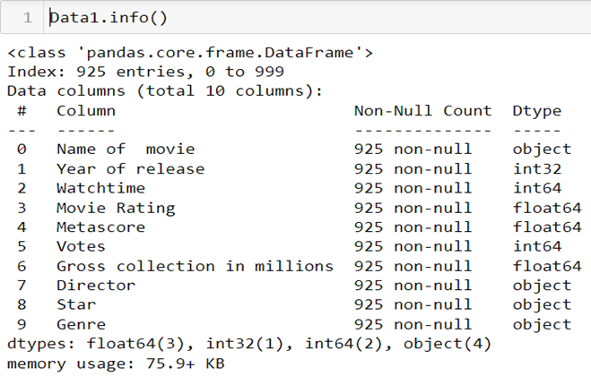
DATA CLEANING PROCESS:
Removing special characters.
Units conversation.
Identifying & imputing of missing values.
Type casting.
Drop the duplicate column.

Slide 9
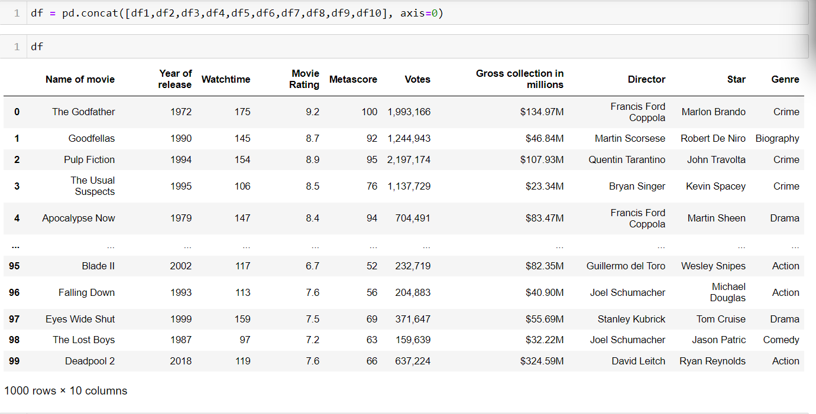
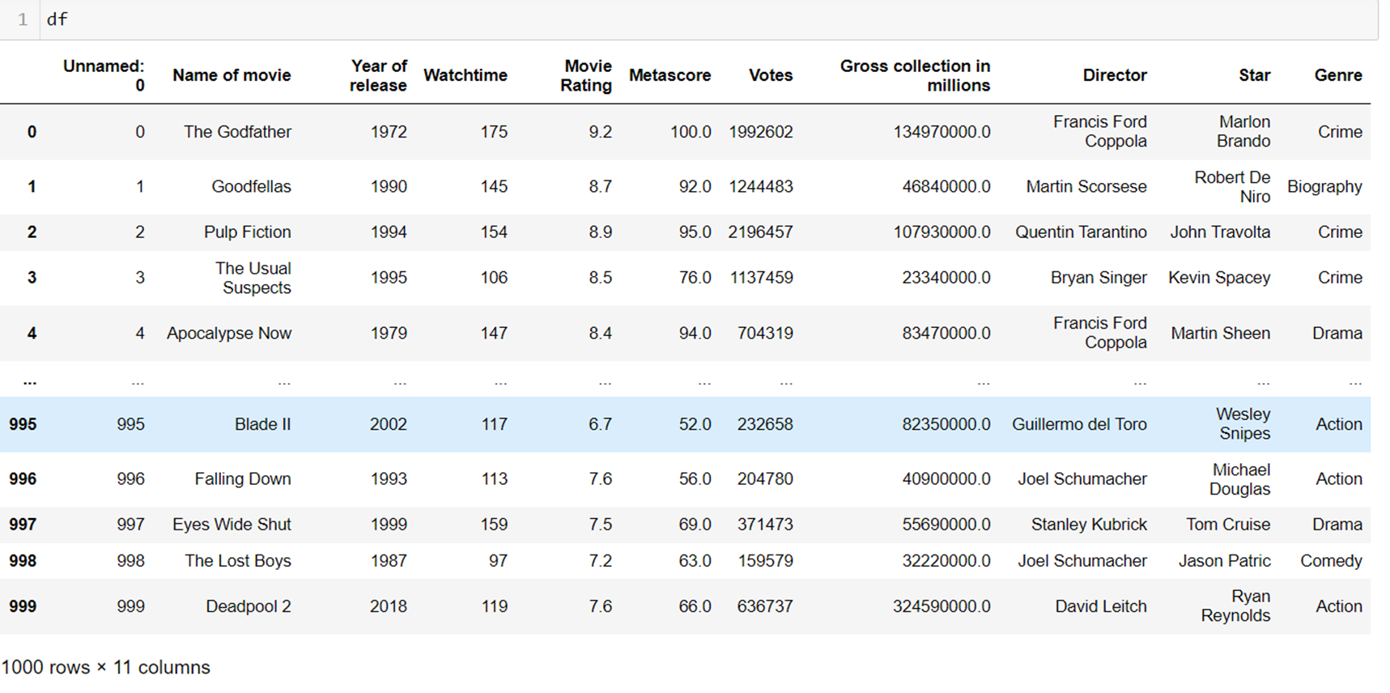
DATA MANIPULATION

Slide 10
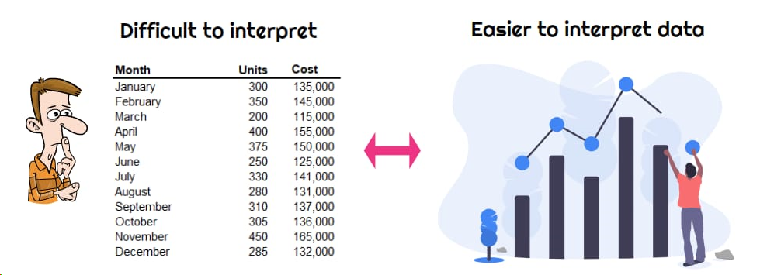
DATA VISUALIZATION

Slide 11
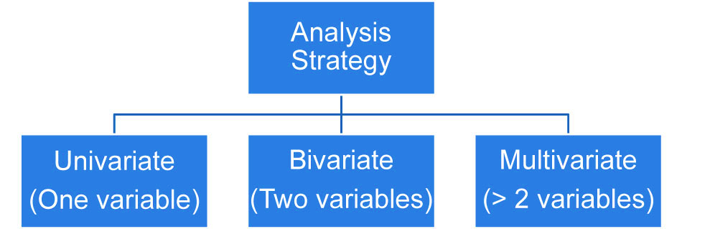
DATA VISUALIZATION
3. MULTI - VARIATE:
More than two columns we can take
3.1 Categorical-Numerical-Categorical
3.2 Categorical-Numerical-Numerical
3.3 Categorical-Categorical-Categorical
3.4 Numerical-Numerical-Numerical
1. UNI-VARIATE:
1.1 Single categorical
1.2 Single numerical
2. BI-VARIATE:
2.1 Categorical-Numerical
2.2 Numerical-Numerical
2.3 Categorical-Categorical

Slide 12
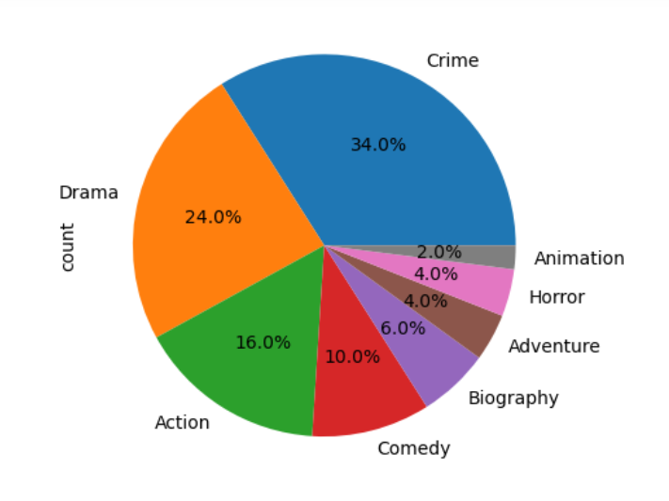
HIGHEST GENRES
From this pie plot, we can observe the movies having highest genre.
Crime genre has the highest count and occupied the first place. Drama ranked second highest in our data.
Whereas , Animation has the lowest count.

Slide 13
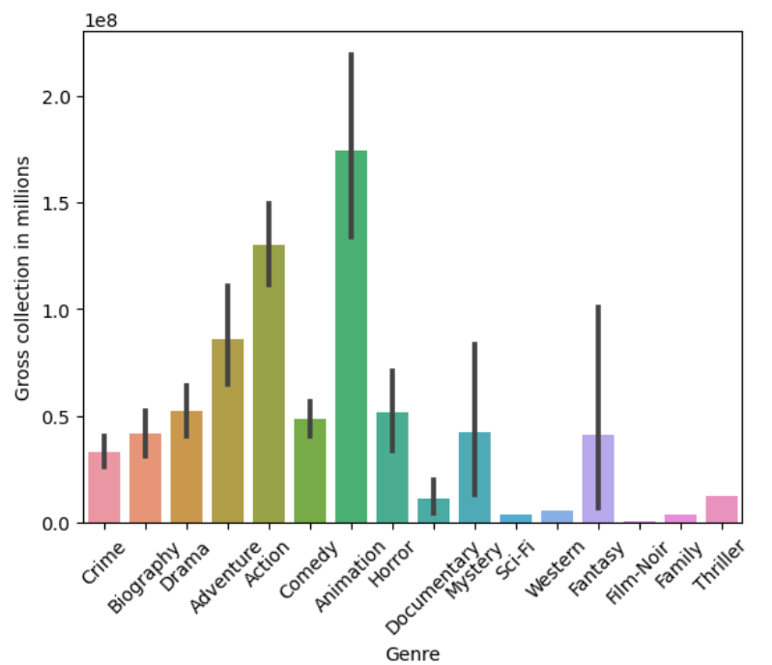
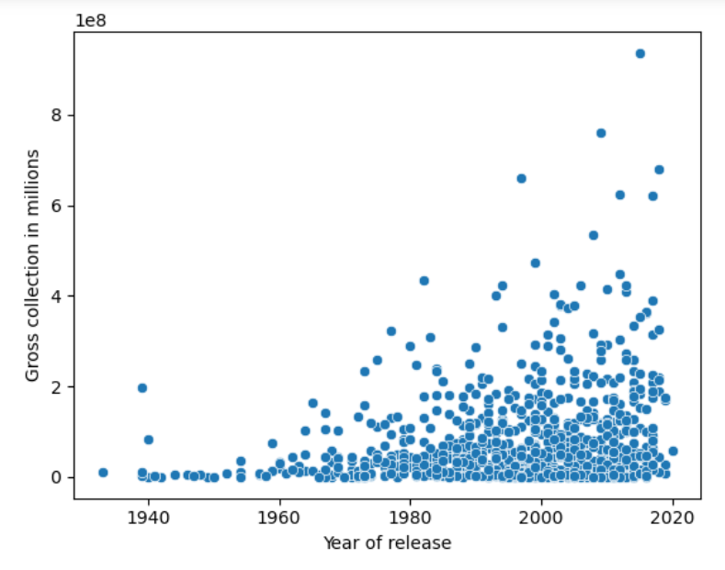
From the above bar plot , the gross collection is maximum for ANIMATION.
Gross Collection Per Genres
Gross Collection In Year
From the above scatter plot , the gross collection is increased in the period of 1980 to 2020.

Slide 14
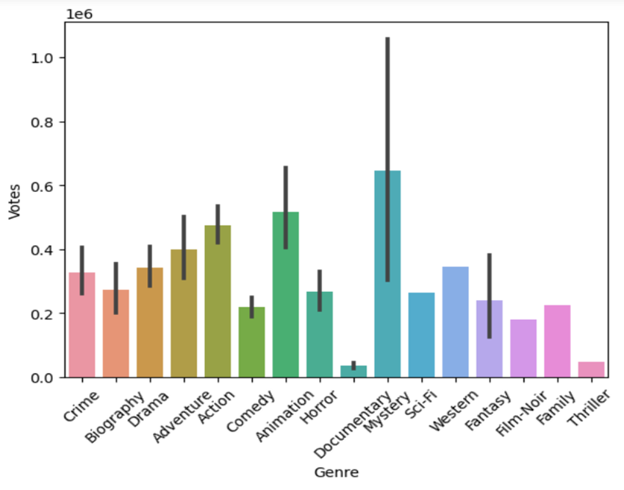
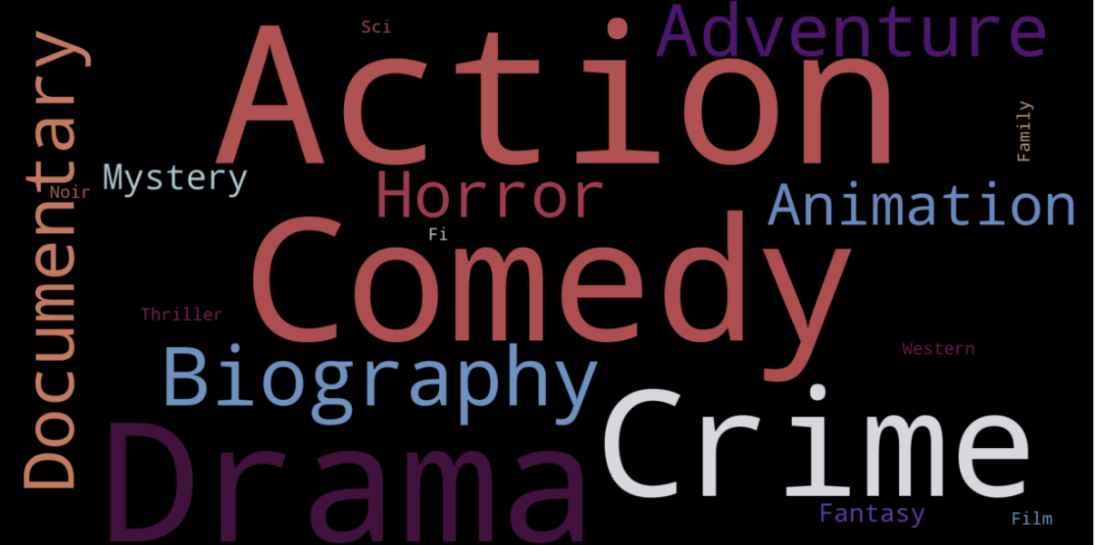
Highest Votes Based On Genres
Different Genres with Their Count
According to the above Word cloud, we have observed that ACTION,COMEDY,CRIME,DRAMA have highest movie ratings.
From the above barplot , Mystery genre got the highest votes.

Slide 15
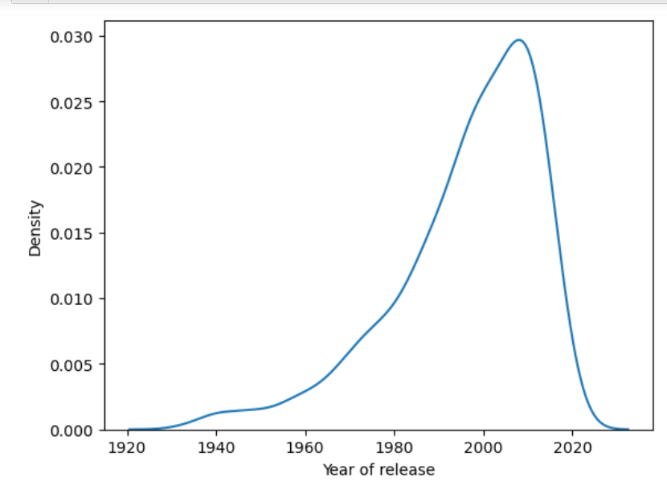
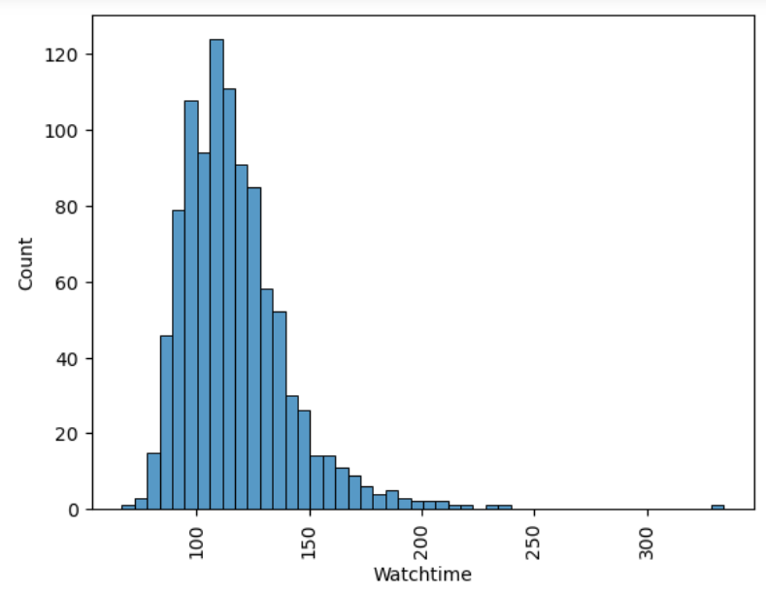
From the above kde plot, the year of release is increased in the period of 2000.
Trends of Movies Release Year
Count Of Maximum Watch time
From the above histplot , the
watchtime of the movies is
maximum at 110 minutes.

Slide 16
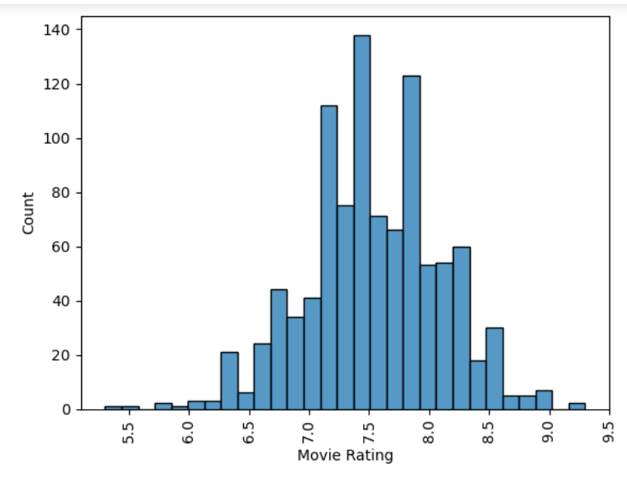
HIGHEST MOVIE RATING
From this histplot , we can say that most of the movies is having 7.5 movie rating.
Least movie rating is 5.5 from the data.

Slide 17
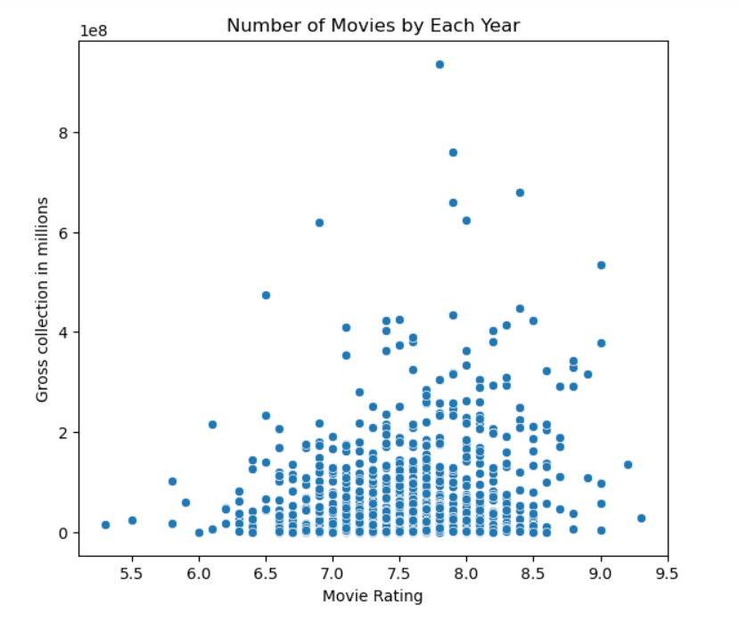
GROSS COLLECTION ACCORDING TO RATING
In this scatter plot , the movie ratings is mostly recorded at 7 to 8.5 ratings .
And the maximum gross collections is recorded in between 1 million to 4 millions.

Slide 18
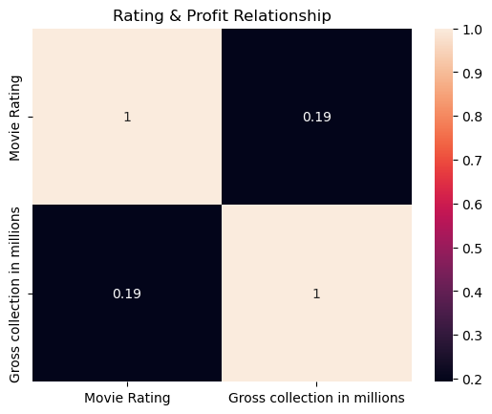
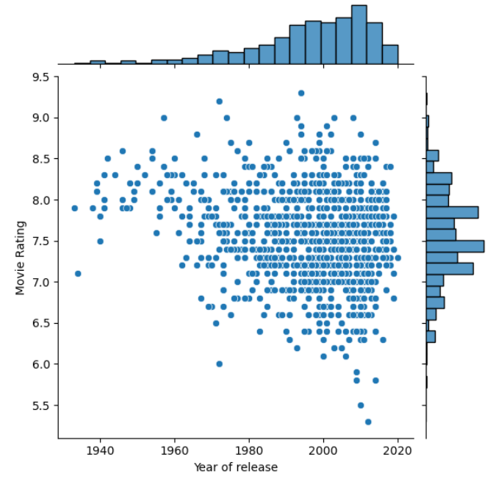
From the above jointplot , we can say that the maximum movie rating is recorded at the period of 1980-2020 .
Co relation Btw Rating &Gross
Most Rated Movies In Year
From the above heatmap, we can say that there
is no Corelation between Rating & Gross.

Slide 19
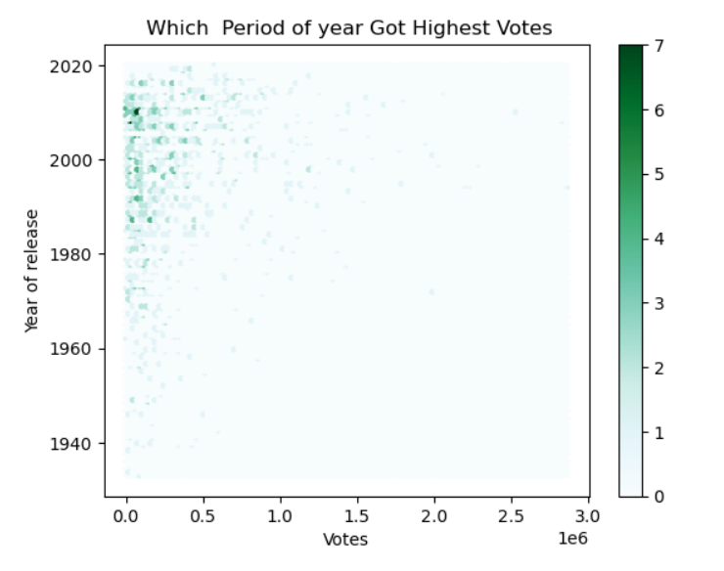
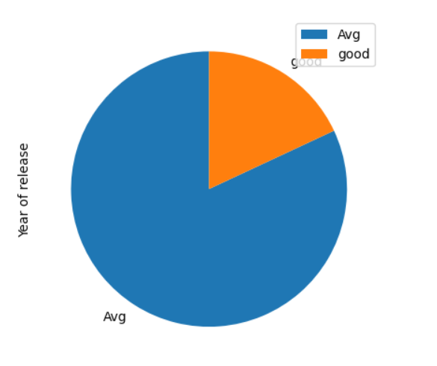
Highest Votes in Year
Average Ratings
23.6%
76.4%
From the above pie plot , we can assume that most of the year of movie released are having Average ratings.
In the above plot , the highest votes is recorded in the period of 2000-2020.

Slide 20
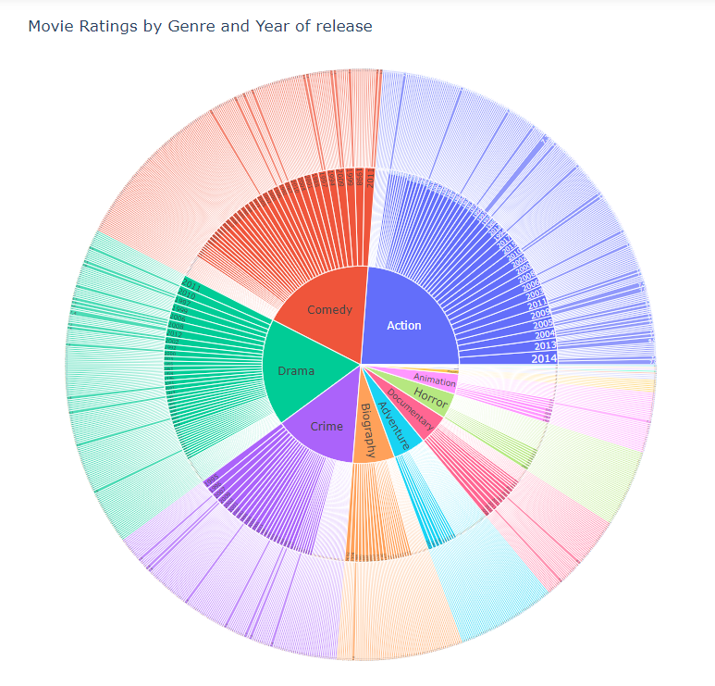
Movie Ratings By Genres and Year of Release
Sunburst chart is used to visualize relationships within hierarchical data.
From this Sunburst plot ,
there is a total of 12 action
movies which are having
highest movie ratings in
the year of 2014.
http://localhost:8888/notebooks/Downloads/Final%20EDA%20Project%20-MAIN%20(1).ipynb

Slide 21
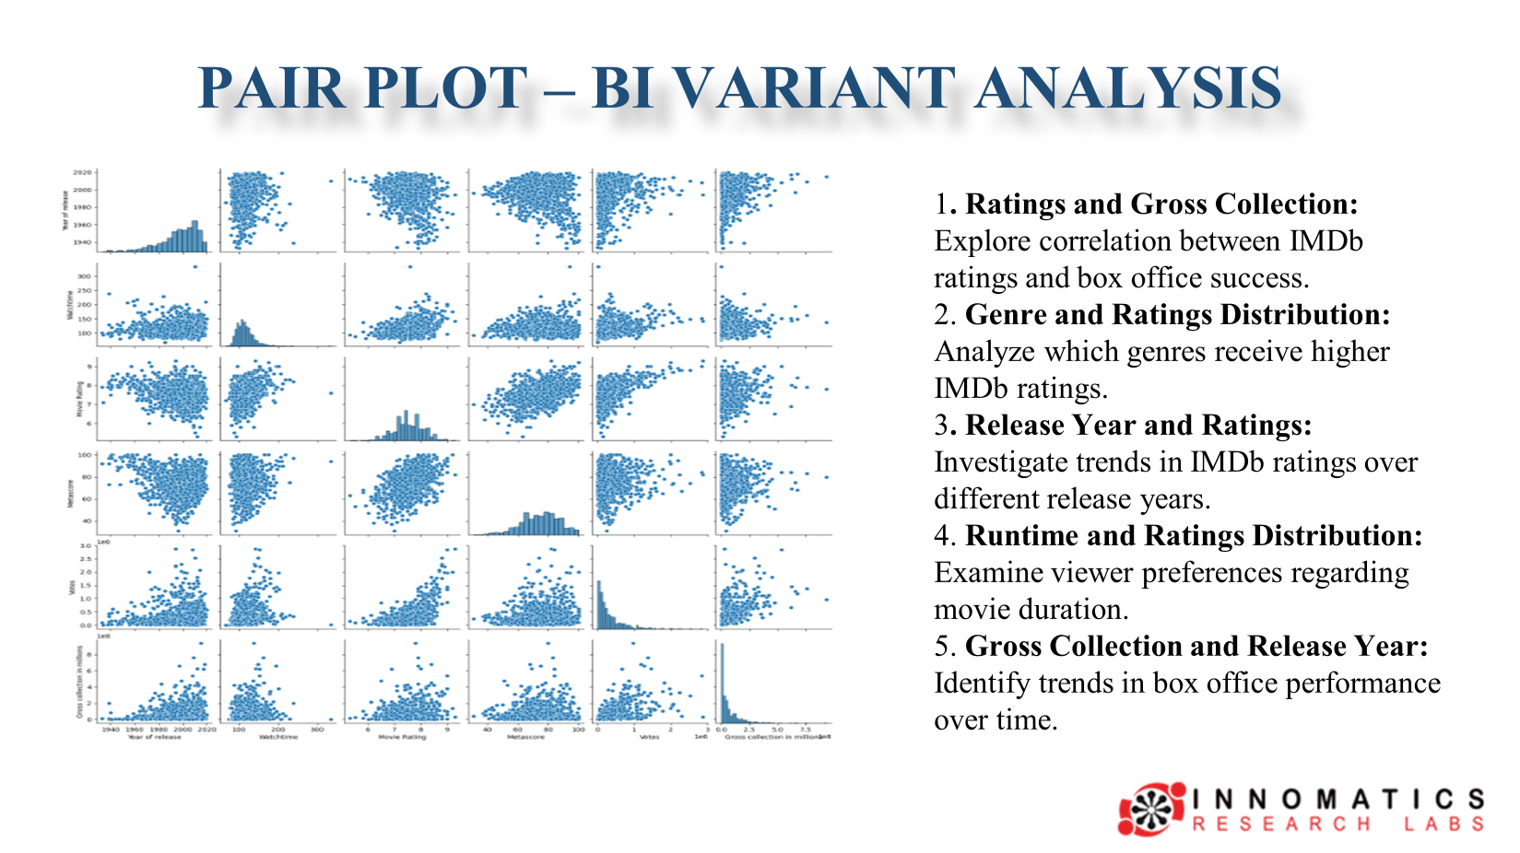

Slide 22
CONCLUSION
1. Crime genre is preferred over Animation, indicating audience interest in specific themes.
2. Higher movie ratings, especially near 8.0, correlate with increased success and acclaim.
3. Optimal movie duration around 110 minutes enhances viewer engagement.
4. Successful movies typically gross between 1 to 4 million, indicating financial viability and audience appeal.
So Finally A Crime Movie with 110 minutes Watch time , can engage Lot of audience for Movie Success.

Slide 23


Slide 24

THANK YOU

